Slide 1
Nutrient Deficiencies
Caitlin Shewbrooks

Slide 2
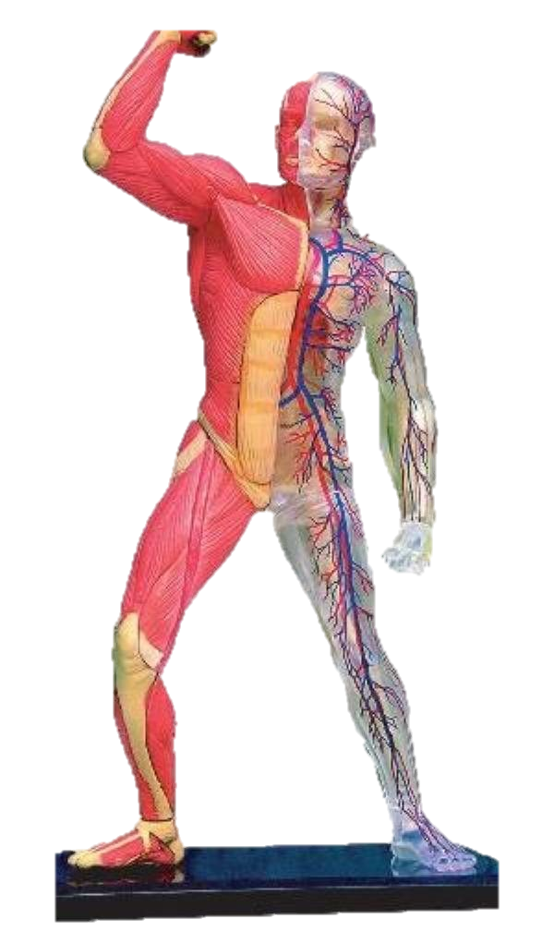
Click arrows to discover what deficiencies alter that body part!
Click the apple at the bottom right of the slide to return here, and this specific apple when you’re finished!

Slide 3
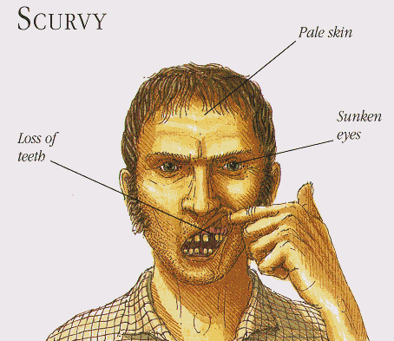
Scurvy
Lack of Vitamin C
Obtained from fruits and vegetables
Symptoms: appetite loss, poor weight gain, diarrhea, fever, and many more
Sometimes results in ulceration of the gums and loss of teeth

Slide 4
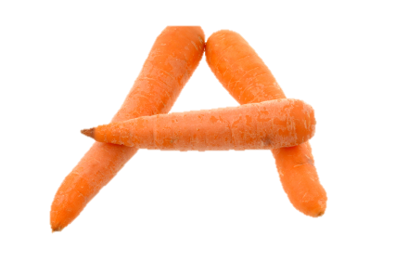
Lack of Vitamin A
Increased susceptibility to cancer
Acne
Night blindness and other eye problems
Skin may become rough and scaly
Makes it difficult for children to fight off infection
If in need of Vitamin A:
Eat eggs, liver, meat, and milk

Slide 5
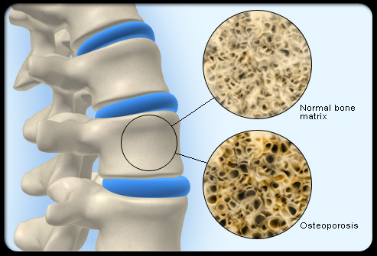
Osteoporosis
Disease that weakens bones over time
Key risk factors: lack of calcium and vitamin D, lack of exercise, and family history
Decreases bone density which leads to easy fracture
Calcium, collagen, and protein are important for strong bones

Slide 6
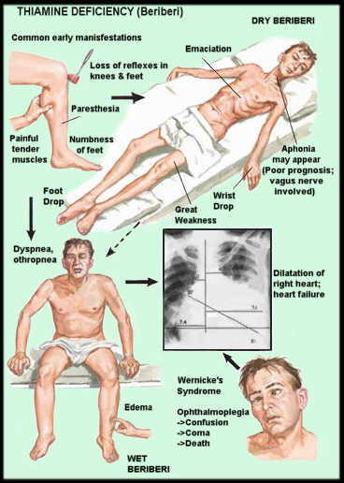
Beriberi
Inflammation of multiple nerves
Swelling due to lack of Vitamin B1 in the diet
Both dry and wet beriberi are possible
Wet can lead to heart failure
Dry can lead to great weakness
Death is a possibility

Slide 7
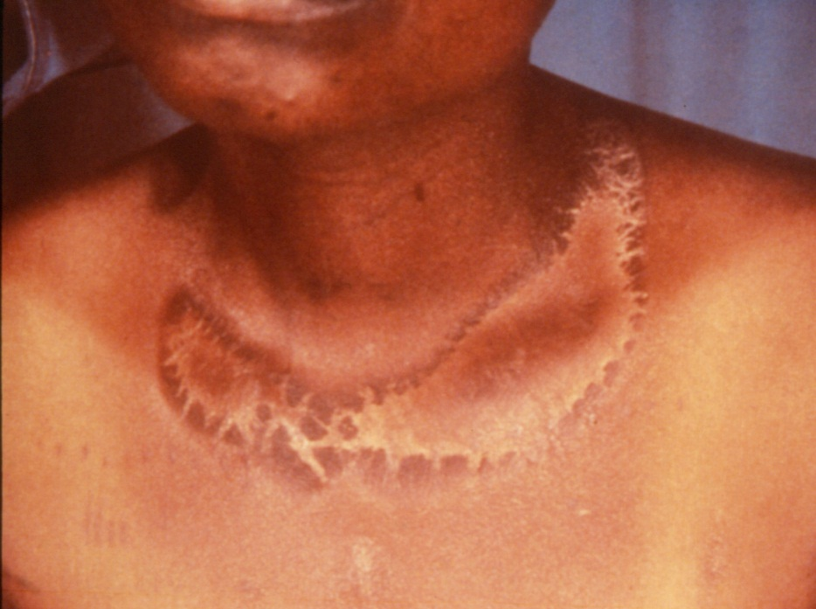
Pellagra
The three D’s: dermatitis, dementia, and diarrhea
Affects digestive system, skin, and nerves
Circulatory problems and heart disease
Lack of Vitamin B3
Usually due to malnutrition or alcohol abuse

Slide 8
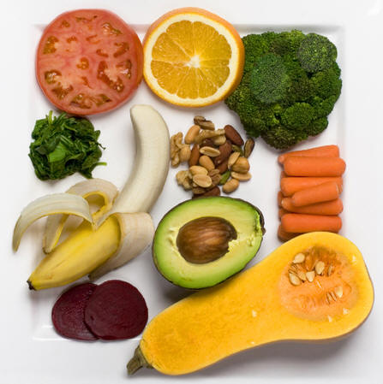
K Deficiency
Potassium
Can be obtained from tomatoes, bananas, and carrots
Leads to heart irregularities
Increased blood pressure
Muscle twitches

Slide 9
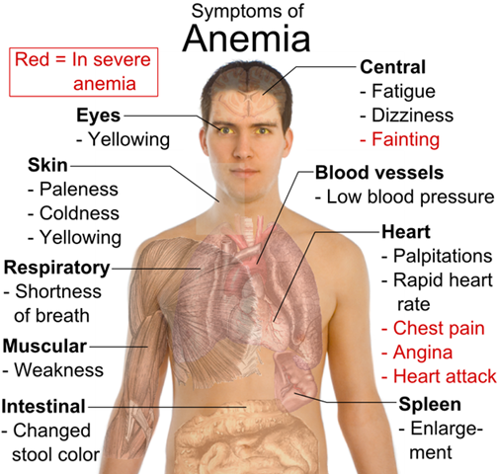
Anemia
Lack of iron
Can be obtained from red meats
Leads to fatigue and weakness
Low energy
Clotting and bruising problems

Slide 10
Lack of Carbs
Decreased energy
Problems with muscle function
Digestive difficulty
Kidney stones
Heart disease
When in need of healthy carbs:
Whole wheat grains, beans, and fruits

Slide 11
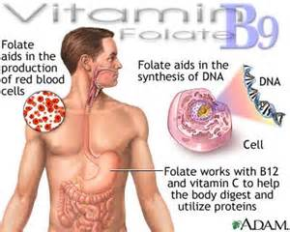
Folate Deficiency
Folic deficiency anemia
Loss of appetite
Weight loss
Weakness, sore tongue, headaches
Possible depression
Occurs when folate intake is inadequate
Tanning beds/UV Light can cause deficiency

Slide 12
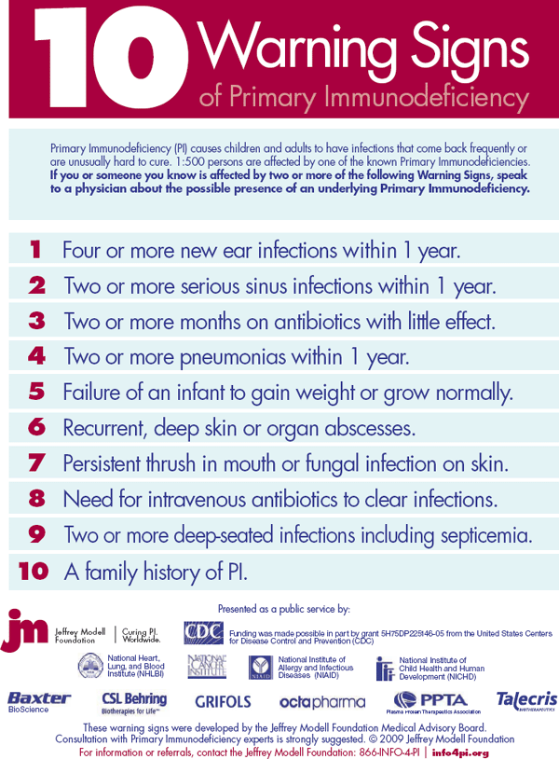
Immune Deficiency
Individuals who do not get enough vitamins and nutrients are at risk
Caused by poor diet
Cancer is a possibility
Frequent or prolonged infection
Immune system does not work the same/has trouble fighting infection
Tiredness or weakness

Slide 13
Moral of the story is…

